Slide 1

Java SDK - Java Development Kit
The Java Development Kit is a distribution of Java Technology by Oracle Corporation. It implements the Java Language Specification and the Java Virtual Machine Specification and provides the Standard Edition of the Java Application Programming

Slide 2

Eclipse – our framework
Eclipse is an integrated development environment used in computer programming. It contains a base workspace and an extensible plug-in system for customizing the environment. It is the second-most-popular IDE for Java development, and, until 2016,

Slide 3
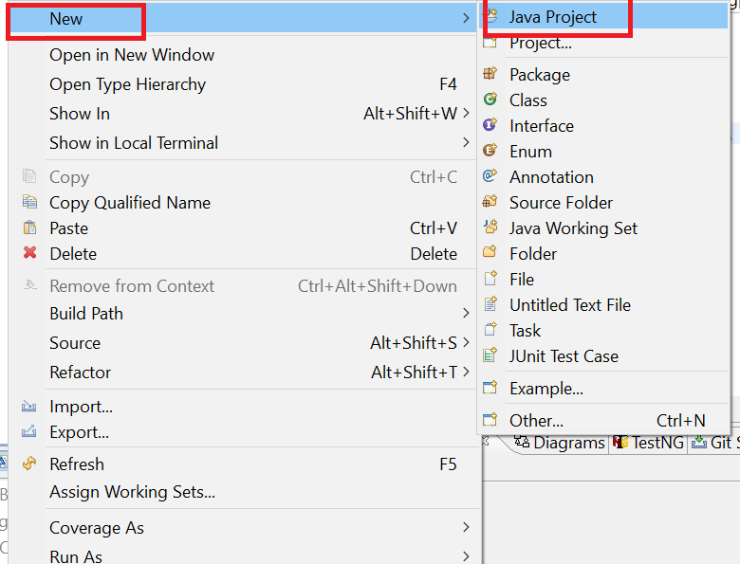
ניצור פרוייקט חדש

Slide 4
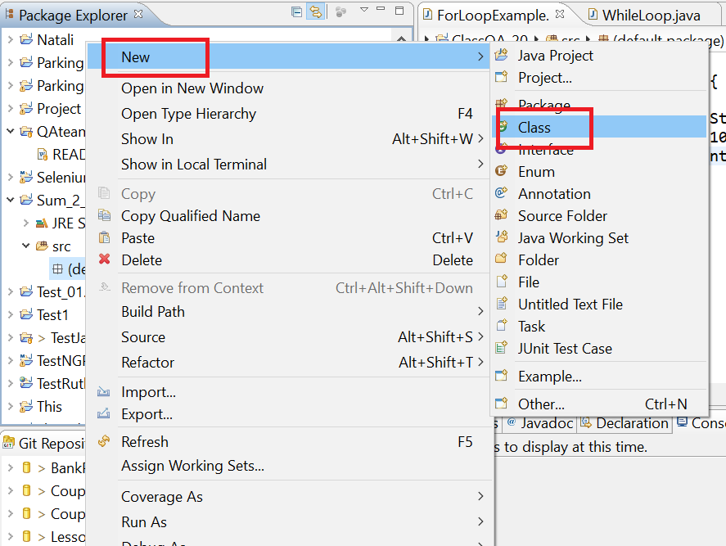
ניצור CLASS חדש

Slide 5
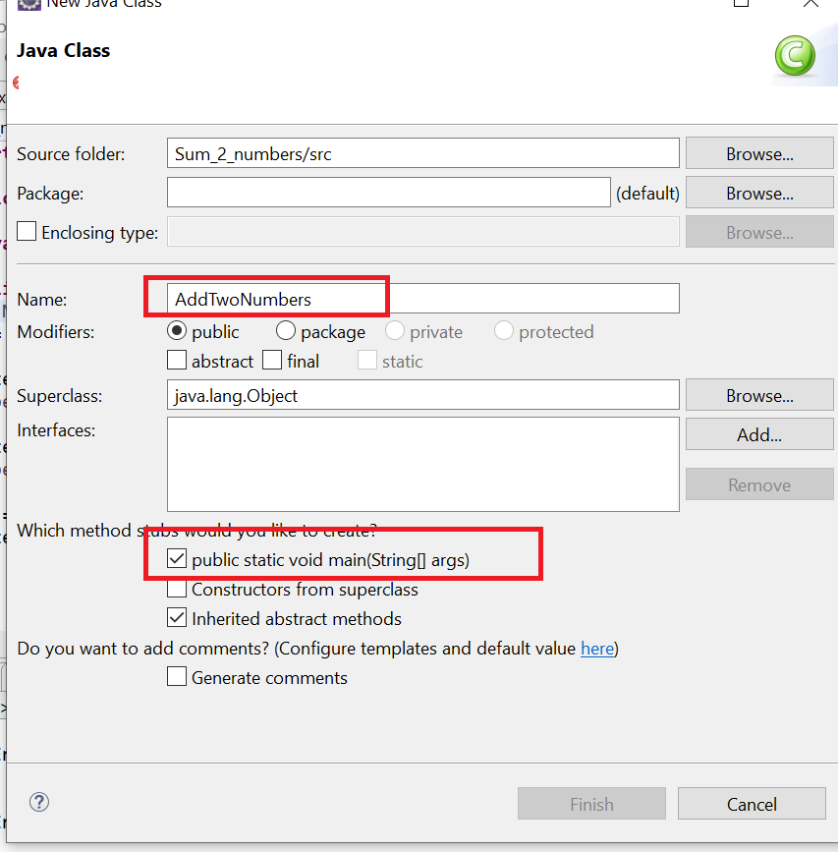
ניתן שם ונסמן להוסיף MAIN

Slide 6
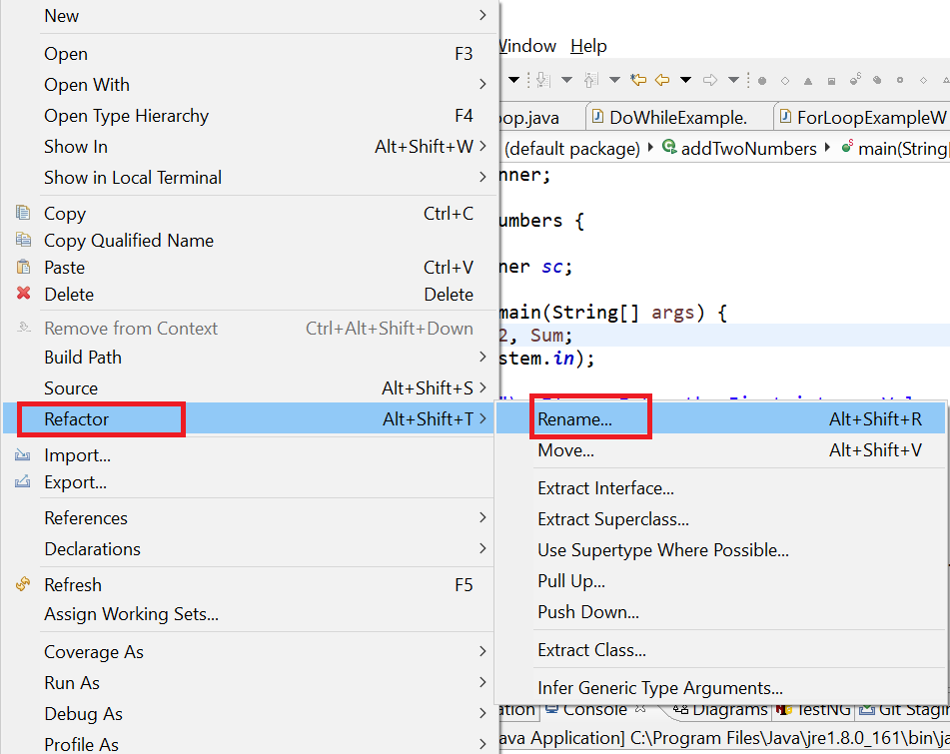
לשנות שם של מחלקה או - CLASS Refactor

Slide 7
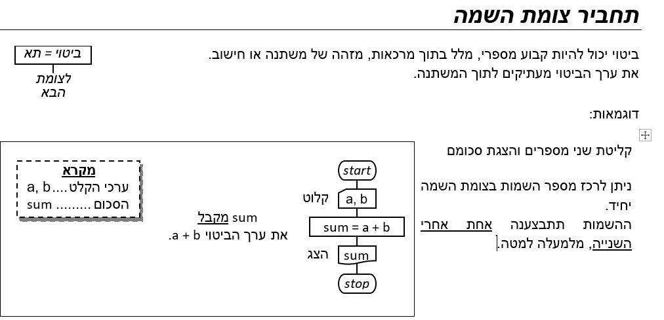

Slide 8
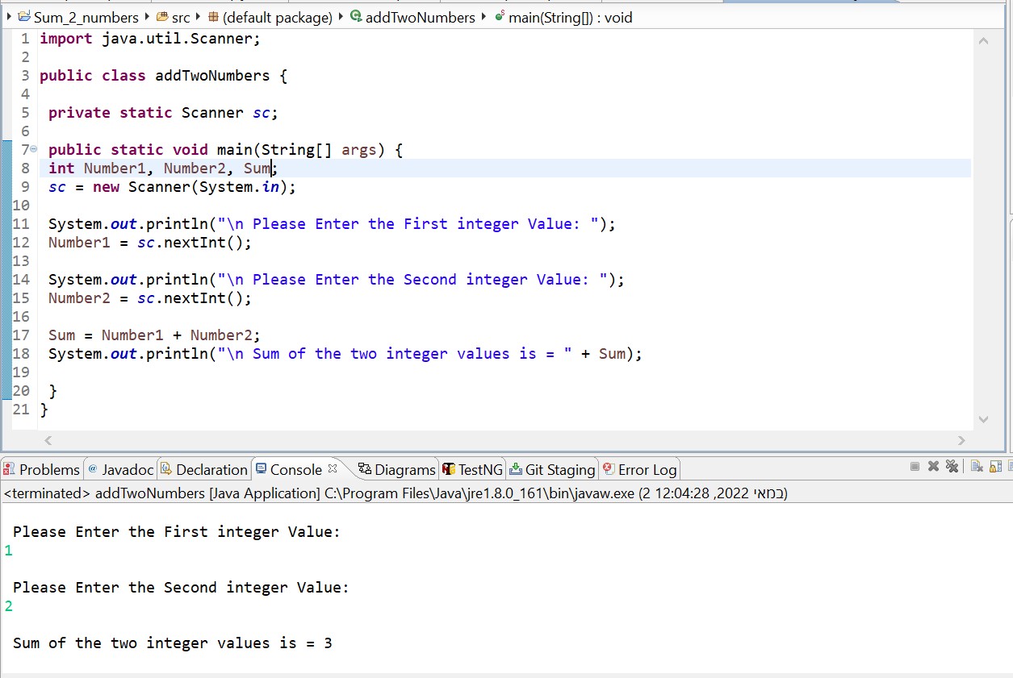

Slide 9
Java - Naming Conventions for a different type of Identifiers
Package
The Package name should be in all lower case.
Example
package com.tutorialspoint;
Class
All the words of a class name should start with an upper case character.
Example
class TutorialsPointClass { // some statements }
Method
Methods should be verbs with the first letter lowercase and the first letter of each internal word capitalized.
Example
class TutorialsPointClass { void printMessage() { } }
Variable
The first word should be in lower case and the internal words start with capital letters.
Variable names should not start with underscore _ or dollar sign $ characters.
Example
class TutorialsPointClass { int rollNum; String firstName; String lastName; }
Constant
All the characters should be in upper case.
Example
class TutorialsPointClass { public static final int MAX_score = 100; }

Slide 10
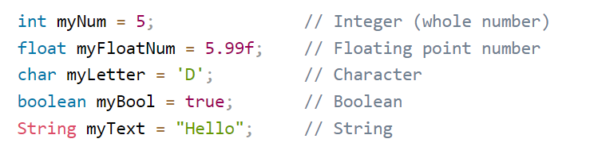
Java Data Types

Slide 11
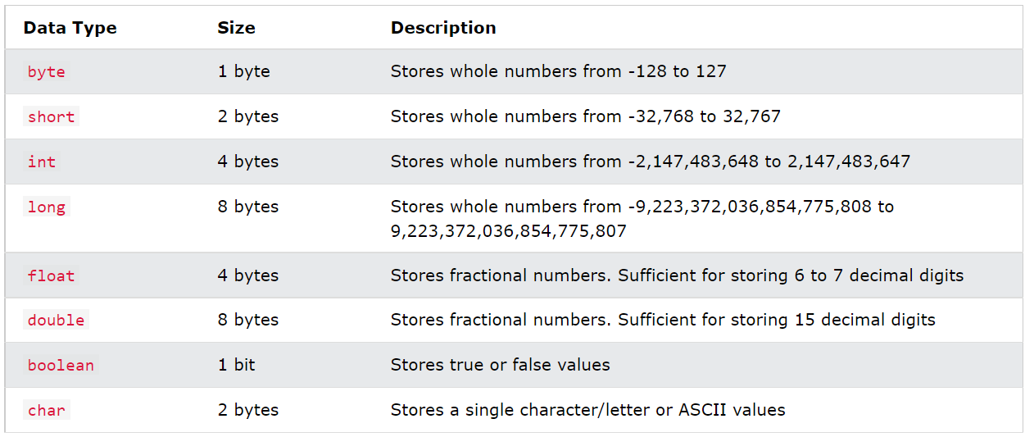
Java Data Types – in details

Slide 12
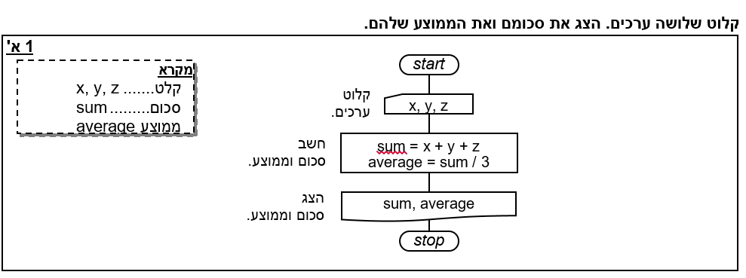

Slide 13
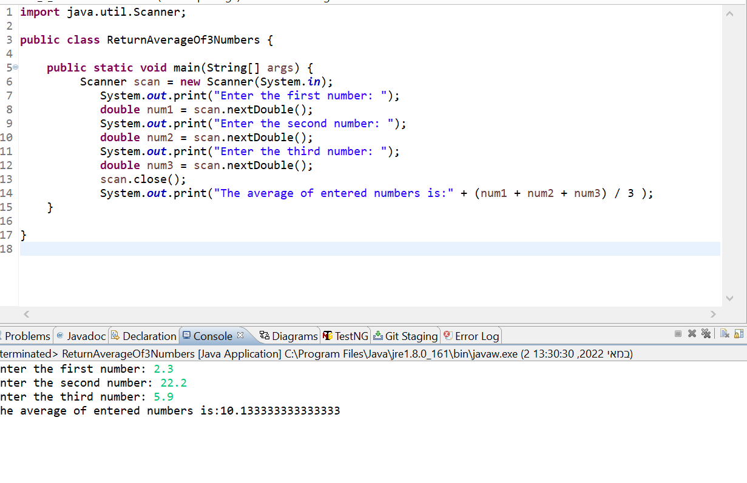

Slide 14
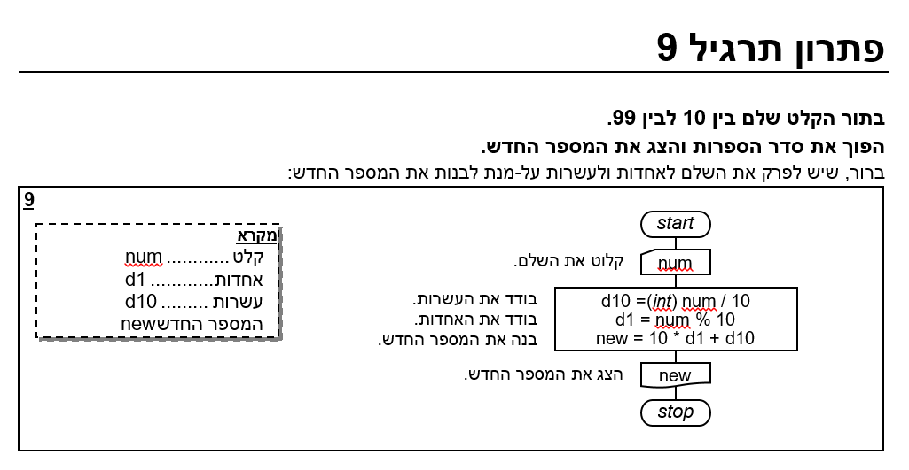

Slide 15
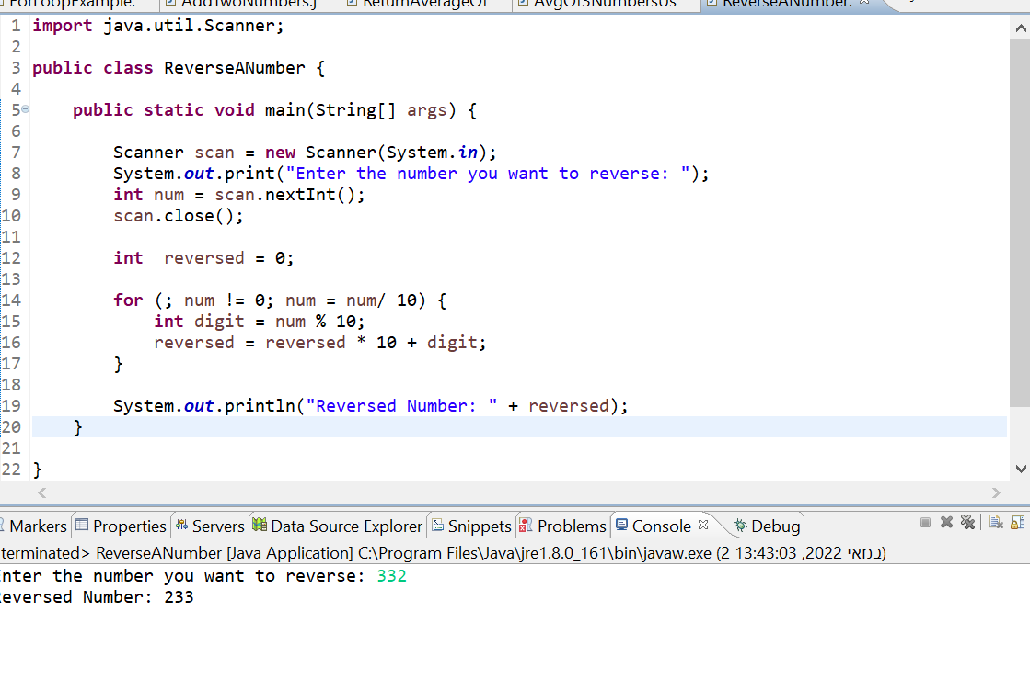

Slide 16
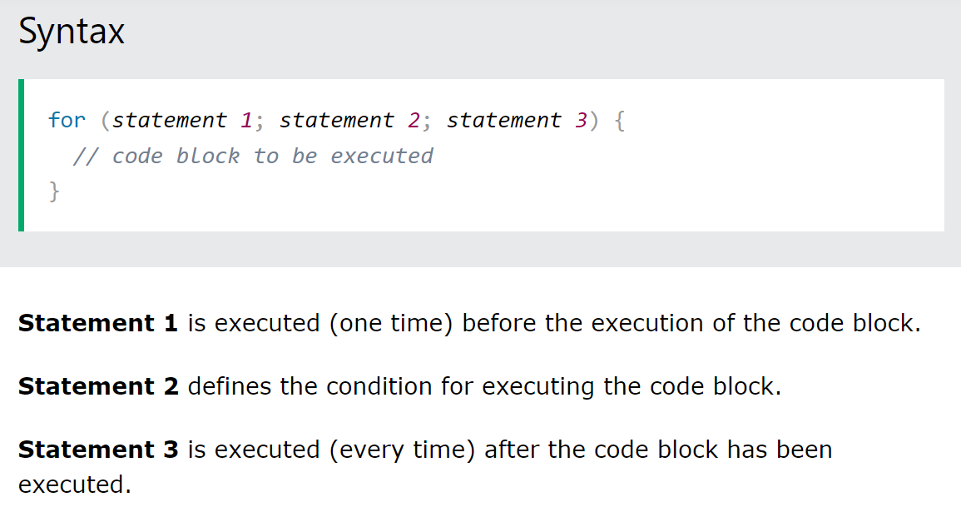
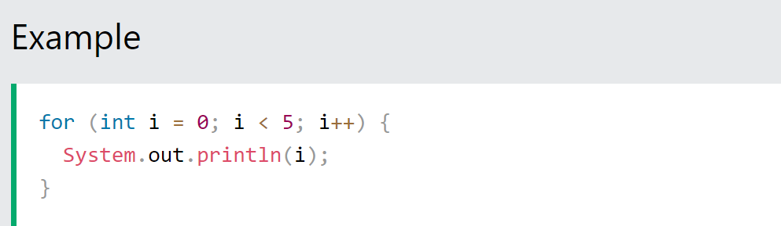
Java For Loop – Structure and example

Slide 17
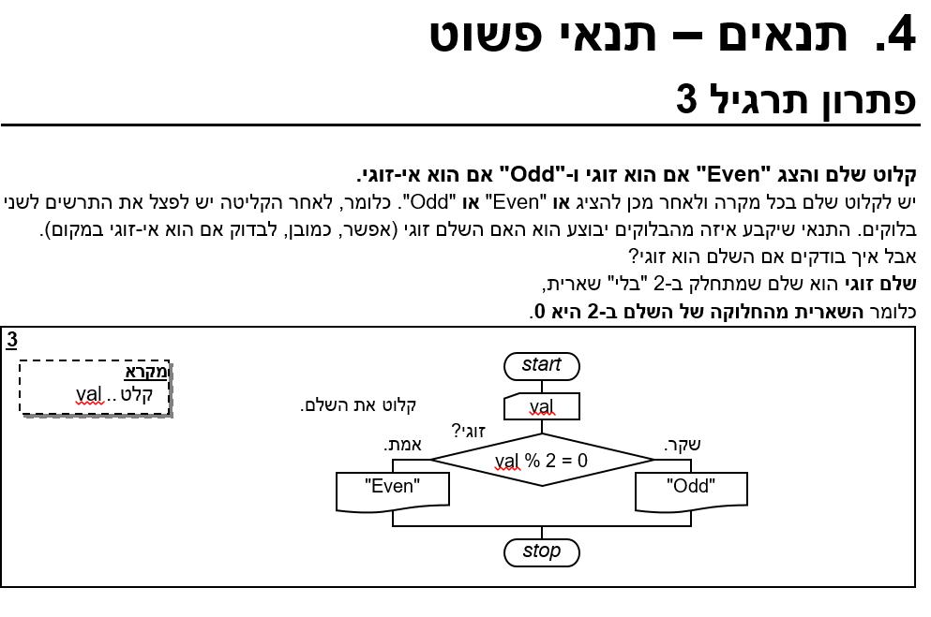

Slide 18
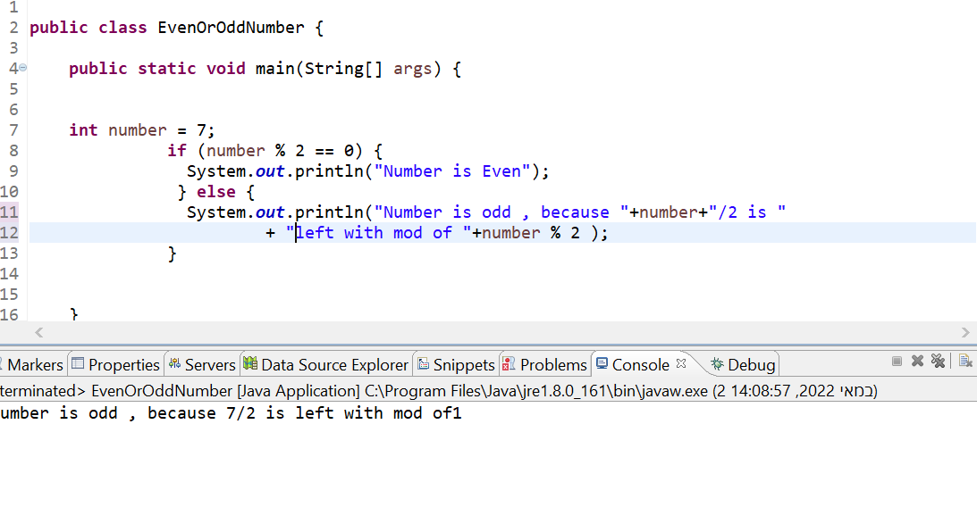

Slide 19
Modulo Method
First need to divide the Dividend by the Divisor:
72 = 3.50
Next we take the Whole part of the Quotient (3) and multiply that by the Divisor (2):
3 x 2 = 6
And finally, we take the answer in the second step and subtract it from the Dividend to get the answer to 7 mod 2:
7 - 6 = 1
As you can see, the answer to 7 mod 2 is 1.

Slide 20
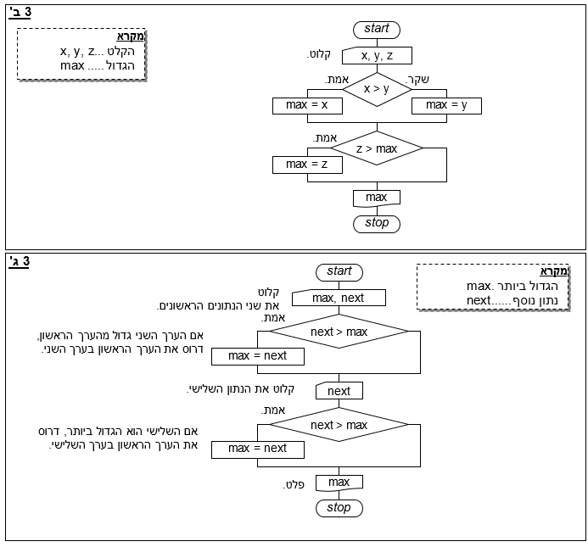
Max of 3 numbers

Slide 21
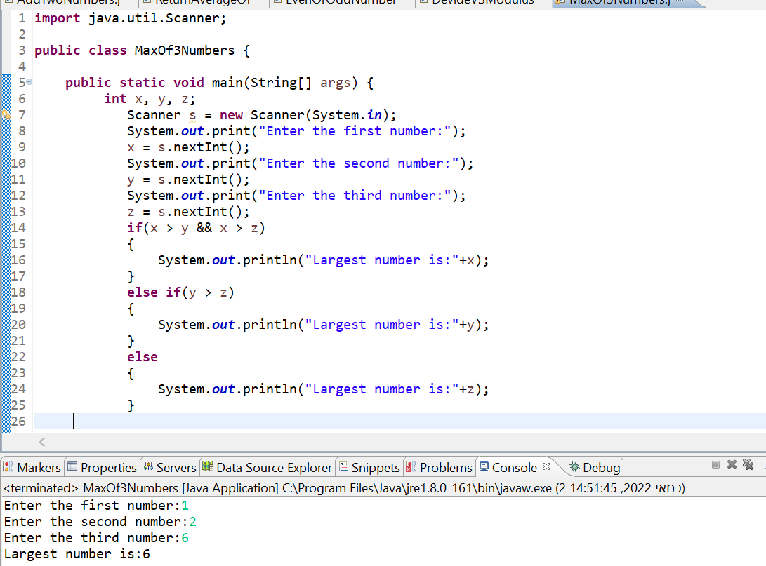

Slide 22
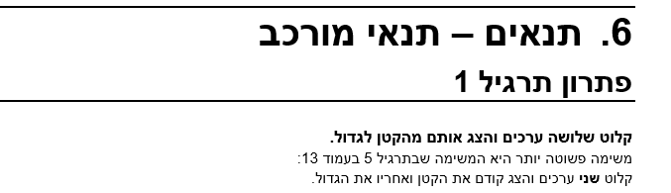
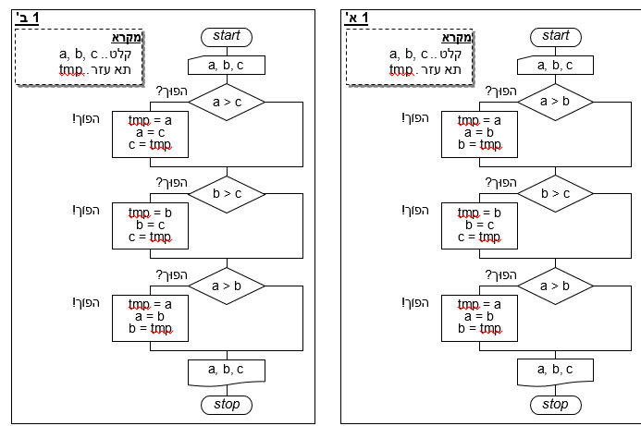

Slide 23
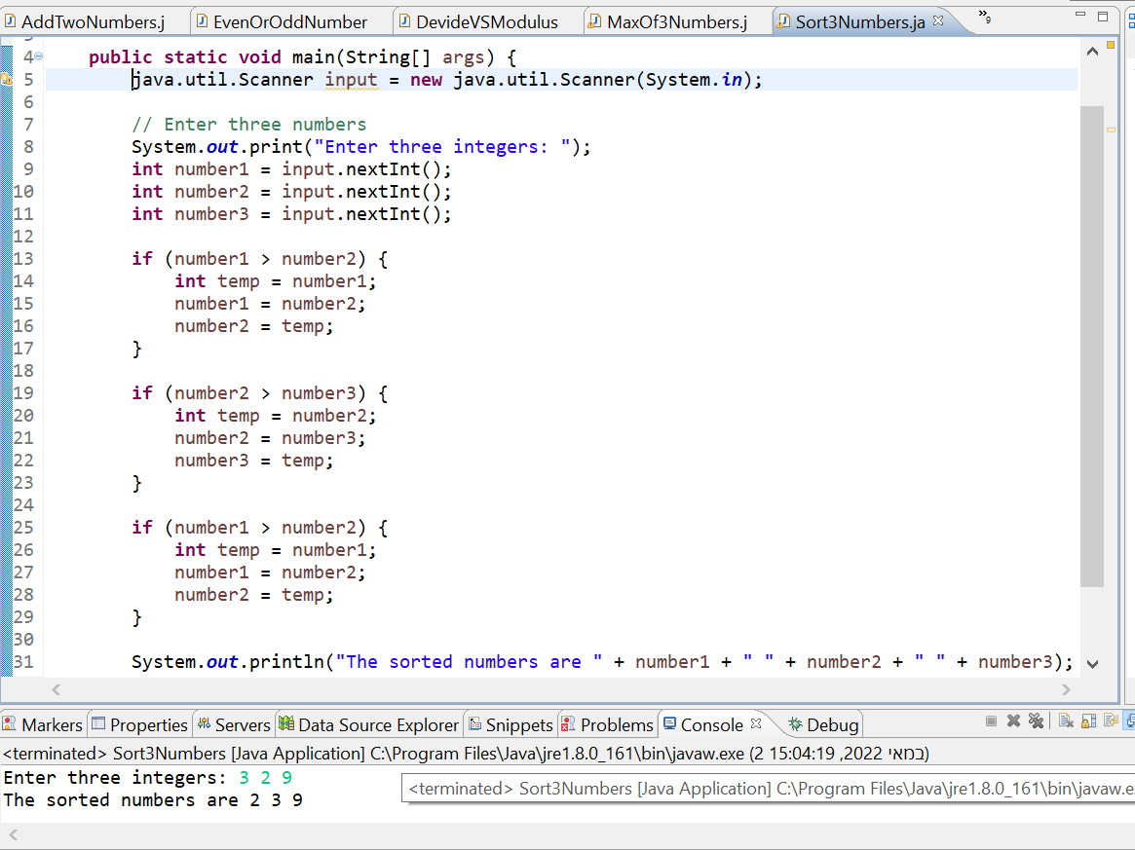

Slide 24
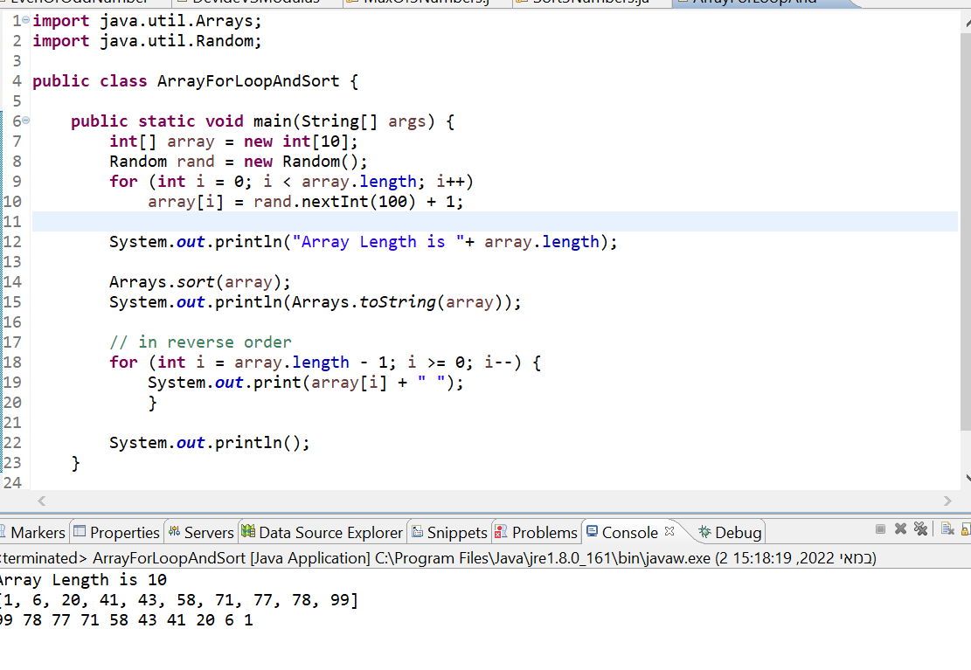
קלוט 10 ערכים רנדומליים לתוך מערך סדר אותו והפוך אותו

